Slide 1
Presentation On Smart City-AIOT Project
Presented By
Tejashwini R[1AP21IS052]
Keerthana M [1AP21CS021]
Vinay Kumar GR [1AP22EC408]

Slide 2
Agenda
Objectives.
Applications.
Equipment's Used.
Flow Chart.
Conclusion.
.

Slide 3
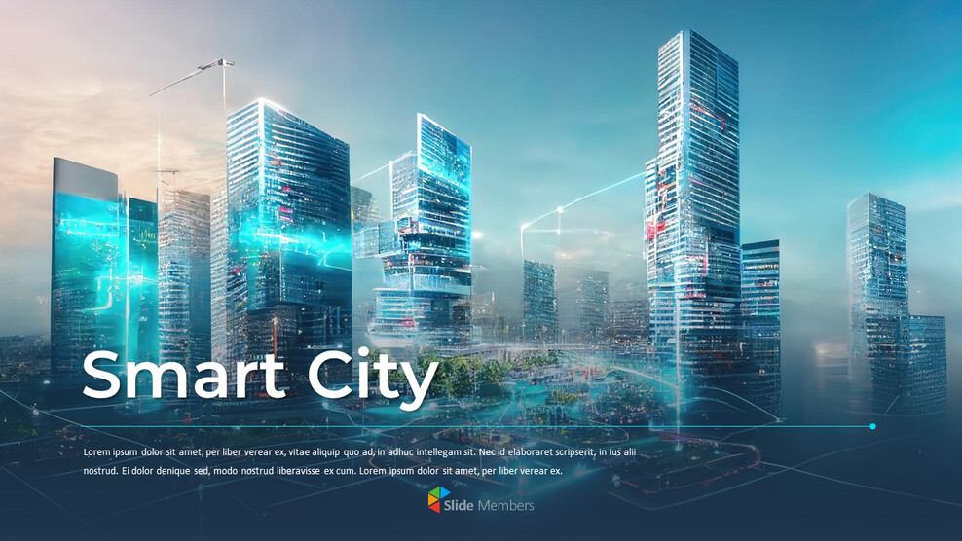
OBJECTIVES
To develop a Smart Traffic Management System that optimizes traffic flow, reduces congestion, and enhances road safety using IoT-enabled sensors and real-time data analytics.

Slide 4
Applications
Detection and Management of traffic Congestion.
Improved Traffic Flow and Public Safety.
Real-Time Monitoring and Reporting.
Vehicle prioritizaition.
Automatic tolling.
Accident detection and response

Slide 5
Equipment's Used
Ultrasonic sensor
Raspberry Pi 4 model B
Cameras
7-Segement LCD Display

Slide 6
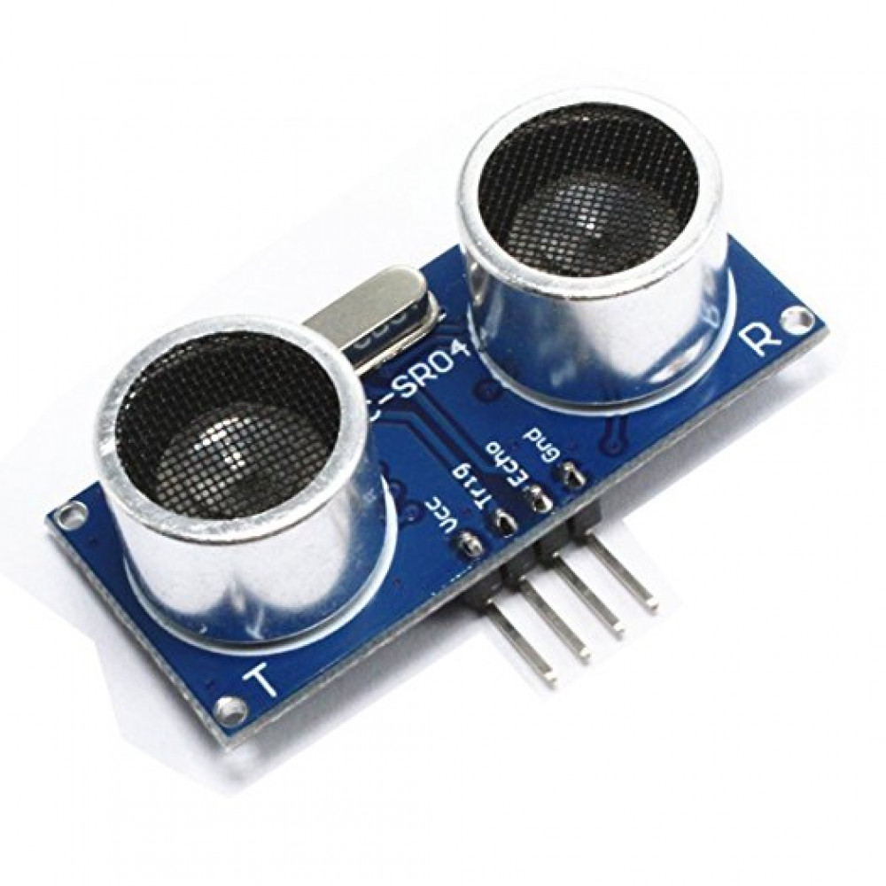
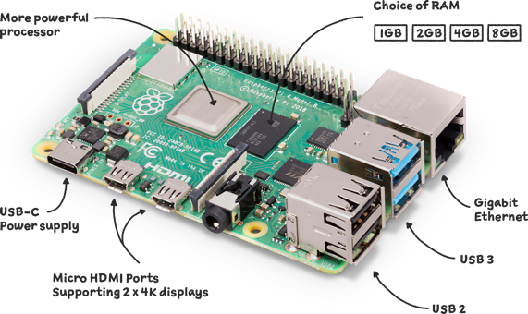
Ultrasonic sensor
An ultrasonic sensor is an electronic device that convert converts the received sound waves into electrical signal.
Raspberry pi 4 model B
Raspberry Pi 4 Model B is a powerful single-board computer that offers significant upgrades.

Slide 7
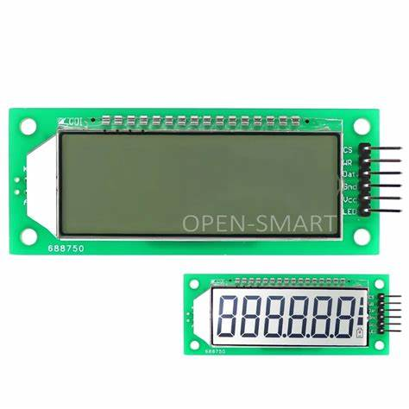
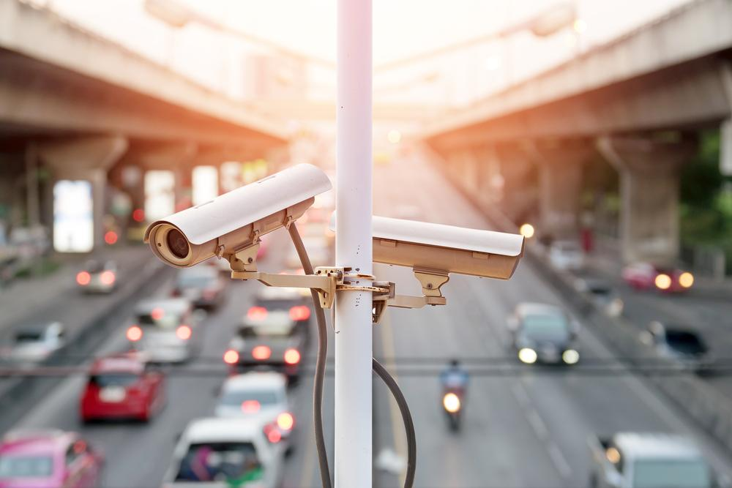
Seven Segment Display
seven-segment display is an electronic device used to display decimal numerals.
Camaras
Cameras caputres images and vedios and monitor traffic flow.

Slide 8
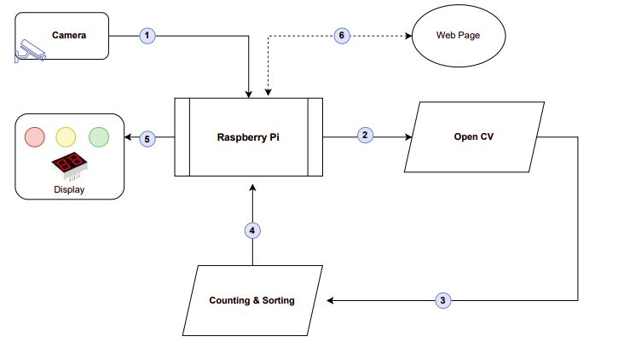
Traffic Management Flow Chart

Slide 9
Pseudo-Code for Traffic Management System
Initialize Flask App and GPIO Setup
Define GPIO pins for data (SDI), latch (RCLK), and clock (SRCLK).
Initialize 7-segment display.
Setup 7-Segment Display Functions
setup display(): Configures GPIO pins for output and sets them to low.
hc595 shift(data): Sends data to the 7-segment display using shift registers.
display number on kit(number): Displays single or double-digit numbers on the 7-segment display.
Traffic Data Structure - Initialize a dictionary traffic data with keys A, B, C, D, and current to, lights, and current active signal. times
Random Traffic Value Generation generate random values(): Generate random values for traffic signals A, B, C, and D.

Slide 10
Conclusion
Improved Traffic Flow: Advanced systems help manage traffic more efficiently, reducing congestion and travel times.
Enhanced Safety: Smart technologies monitor and respond to traffic conditions, helping to prevent accidents and improve road safety.
Environmental Sustainability: By optimizing traffic, these systems reduce vehicle emissions and promote eco-friendly transportation options.
Real-Time Monitoring: IoT devices and sensors provide real-time data on traffic conditions, enabling quick responses to incidents and dynamic traffic control.
Public Transport Efficiency: Integrating smart traffic management with public transport systems can lead to more reliable and efficient services, encouraging more people to use public transit.

Slide 11
Thank you

